Slide 1
Computer Graphics 9th Recitation “OpenGL: Transformations II”
Anna Shtengel
Based on slides by Michael Litvin
11.5.2013

Slide 2
Today!
OpenGL Transformations
Model-view
Projection
Viewport
Depth tests
Fractal Trees

Slide 3














Trackball
Rotate a scene using the mouse
glRotate*() will rotate around $v$ for you!
$$v=v_{1}×v_{2} α=\cos^{−1}\left(\frac{v_{1}}{\left|v_{1}\right|}∙\frac{v_{2}}{\left|v_{2}\right|}\right)$$
$$\left(0,0\right)$$
$$1$$
$$y$$
$$−1$$
$$\left(0,0\right)$$
$$1$$
$$\left(0,0,0\right)$$
$$x$$
$$z$$
$$\left(width,height\right)$$
$$−1$$

Slide 4
Graphical Pipeline
3D Geometric Primitives
Modeling
Transformation
Lighting
Viewing
Transformation
Projection
Transformation
Brief Overview
Clipping
Scan
Conversion
Frame Buffer

Slide 5
Coordinate Systems
Every vertex is transformed from Object coordinates (specified by glVertex()) to World coordinates, then View coordinates and then to Clip coordinates.
This is the coordinate system after projection transformation, which is homogeneous
Then Perspective division is made. This coordinate system is called Normalized Device Coordinates (NDC)

Slide 6
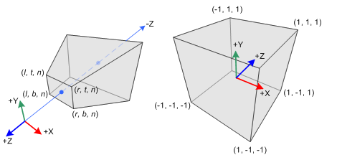
Clipping
The cube in NDC:
X,Y,Z from [-1,1]
Z governs Depth
Clipping – everything outside this cube is clipped thus not rendered
ThenX,Y are transformed
to pixel values (Viewport) and Z is saved
in the Zbuffer for depth test

Slide 7
Projection
OpenGL Transformation
Some slides taken from Alan Lerner: http://www.cs.tau.ac.il/~alan/Teaching/OpenGL/OpenGL.htm

Slide 8
Graphical Pipeline
3D Geometric Primitives
Modeling
Transformation
Lighting
Viewing
Transformation
We Are Here
Projection
Transformation
Clipping
Scan
Conversion
Frame Buffer

Slide 9
Projection
The GL_PROJECTION matrix transforms 3D to 2D
Eye Space→ Clip Space
Usually we will use helper functions to set either:
Orthographic projection (default)
Perspective projection
Remember to first set current matrix to Projection and initialize it to identity
glMatrixMode(GL_PROJECTION); // Select The Projection Matrix
glLoadIdentity(); // Reset The Projection Matrix
// Calculate The Aspect Ratio Of The Window
gluPerspective(45.0f, (GLfloat)width/(GLfloat)height,0.1f,100.0f);

Slide 10
Orthographic Projection
Y axis
(Left, top, near)
(0,0,0)
-Z axis
(Right, bottom, far)
X axis
glOrtho(left, right, bottom, top, -near, -far);
Notes:
לשים לב לצירים

Slide 11
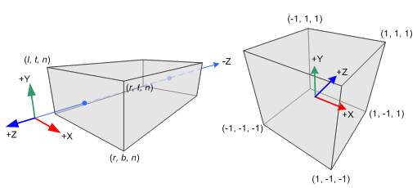
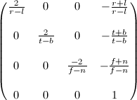
Orthographic Projection
void glOrtho(left, right, bottom, top, near, far);
Creates a matrix for an orthographic parallel viewing volume and multiplies the current matrix by it. Both near and far can be positive or negative.
*
=

Slide 12
Perspective
Y axis
(Left, top, near)
(0,0,0)
-Z axis
far
(Right, bottom, near)
X axis
Frustum = פירמידה קטומה
glFrustum(left, right, bottom, top, -near, -far);
gluPerspective(viewAngle, aspectRatio, -near, -far);
Notes:
ZOOM

Slide 13
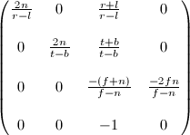
Perspective Projection
void glFrustum(left, right, bottom, top, near, far);
Creates a matrix for a perspective-view frustum and multiplies the current matrix by it. near and far give the distances from the viewpoint to the near and far clipping planes. They should always be positive.
*
=

Slide 14
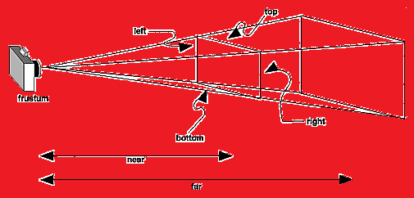
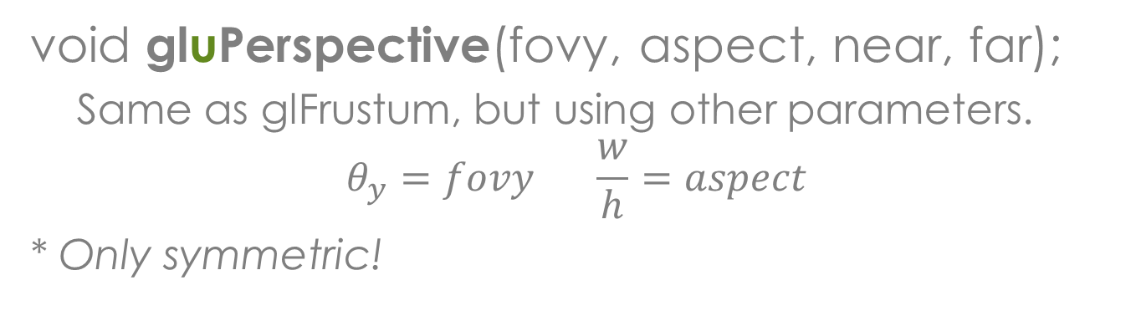
Perspective Projection
void gluPerspective(fovy, aspect, near, far);
Same as glFrustum, but using other parameters.
$$θ_{y}=fovy \frac{w}{h}=aspect$$
* Only symmetric!

Slide 15
Projection Initialization Code – Orthographic
public void reshape(GLAutoDrawable drawable, int x,
int y, int width, int height) {
GL gl = drawable.getGL();
// Change matrix mode to Projection
gl.glMatrixMode(GL.GL_PROJECTION);
// Initialize the projection matrix
gl.glLoadIdentity();
// Define the projection
double w, h;
w = 200;
h = 200 * ((double) height / width);
gl.glOrtho(-w / 2, w / 2, -h / 2, h / 2, -1000, 1000);
}

Slide 16
Projection Initialization Code – Perspective
public void reshape(GLAutoDrawable drawable, int x,
int y, int width, int height) {
GL gl = drawable.getGL();
// Change matrix mode to Projection
gl.glMatrixMode(GL.GL_PROJECTION);
// Initialize the projection matrix
gl.glLoadIdentity();
// Define the projection
double fovy, aspect;
fovy = 45.0;
aspect = ((double)width/height);
GLU glu = new GLU();
glu.gluPerspective(fovy, aspect, 1, 1000);
}

Slide 17
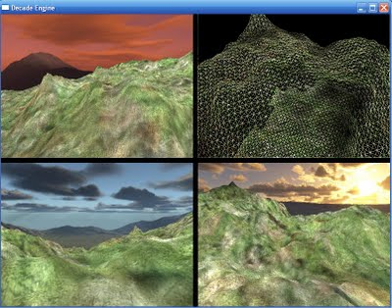
Viewports
From view plane to canvas
(1,1)
(-1,-1)

Slide 18
Graphical Pipeline
3D Geometric Primitives
Modeling
Transformation
Lighting
Viewing
Transformation
Projection
Transformation
Clipping
We Are Here
Scan
Conversion
Frame Buffer

Slide 19
Viewports
The viewport is the portion of the window into which we are going to render.
The viewport does not have to be the size of the entire window, but usually is and it is the default.
Using a viewport that occupies only a part of the window, allows us to create a split screen effect.

Slide 20
Viewport
void glViewport(GLint x, GLint y, GLsizei width, GLsizei height);
Defines a pixel rectangle in the window into which the final image is mapped. The (x, y) parameter specifies the lower-left corner of the viewport, and width and height are the size of the viewport rectangle.

Slide 21
Z-Buffer Method
De-facto hidden surface removal method

Slide 22
OpenGL Buffers
OpenGL uses several buffers for frame pixels:
Color Buffer – Stores color for each pixel
Depth Buffer – Stores depth value for each pixel.
Framebuffer
Color Buffer
Front Left
Front Right
Back Left
Back Right
Depth Buffer
Stencil Buffer
Accumulation Buffer

Slide 23
Graphical Pipeline
3D Geometric Primitives
Modeling
Transformation
Lighting
Viewing
Transformation
Projection
Transformation
Clipping
We Are Here
Scan
Conversion
Frame Buffer

Slide 24
Depth Test
Before writing to a pixel, a test is made to determine whether the new pixel is closer to the viewer then the stored pixel.

Slide 25
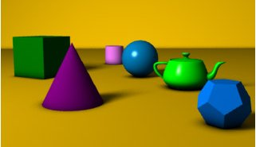
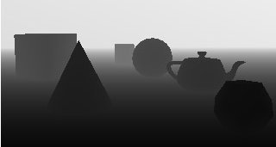
Depth Buffer
Also known as Z-Buffer
Enable/disable writing using
glDepthMask(true) – default
glDepthMask(false)
Enable/disable the test using
glEnable(GL_DEPTH_TEST)
glDisable(GL_DEPTH_TEST) - default

Slide 26
Depth Test Function
Depth testing need to be enabled before use:
glEnable(GL_DEPTH_TEST)
glDepthFunc(…) defines the comparison function
glDepthFunc(GL_LEQUAL)
Pixel with depth < Z-buffer is written
glDepthFunc(GL_LESS) – default
Pixel with depth < Z-buffer is written
glDepthFunc(GL_GREATER)
Pixel with depth > Z-buffer is written

Slide 27
Cleaning Buffers
void glClear(mask);
glClear(GL_COLOR_BUFFER_BIT | GL_DEPTH_BUFFER_BIT);
Clears buffers to preset values
Color buffer preset determined by
glClearColor(float r, float g, float b)
Values are clamped to the range 0..1
Default is 0 for all channels
Depth buffer preset determined by
glClearDepth(float depth)
Values are clamped to the range 0..1
Default is 1

Slide 28
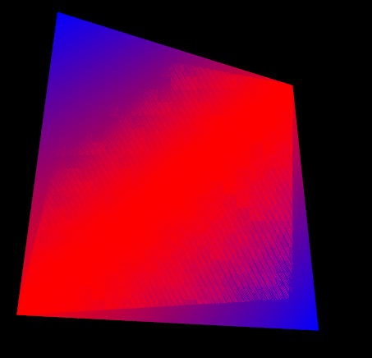
Z-Fighting

Slide 29
Z-Fighting in motion

Slide 30
Z-Buffer Method Conclusion
Advantages:
Simple and easy to use
Disadvantages:
Memory overhead
Finite depth precision can cause problems.
Might spend a lot of time rendering polygons that are not visible.
Does not do transparency easily

Slide 31
Back-Face Culling
void glCullFace( GLenum mode );
Indicates which polygons should be discarded (culled) before they're converted to screen coordinates.
GL_FRONT, GL_BACK, and GL_FRONT_AND_BACK are accepted. The initial value is GL_BACK
To take effect, culling must be enabled using glEnable() with GL_CULL_FACE;

Slide 32
glFrontFace
void glFrontFace(GLenum mode);
Specifies the orientation of front-facing polygons.
GL_CW and GL_CCW are accepted.
The initial value is GL_CCW.

Slide 33
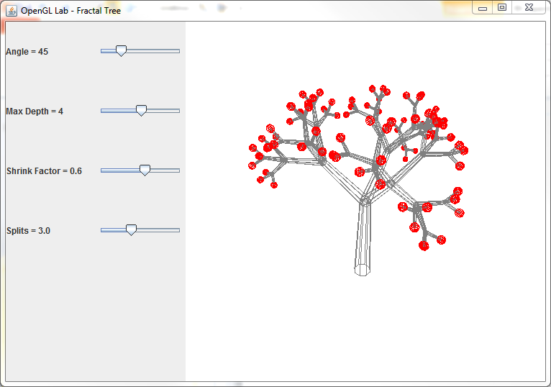
Fractal Trees
OpenGL Transformations

Slide 34
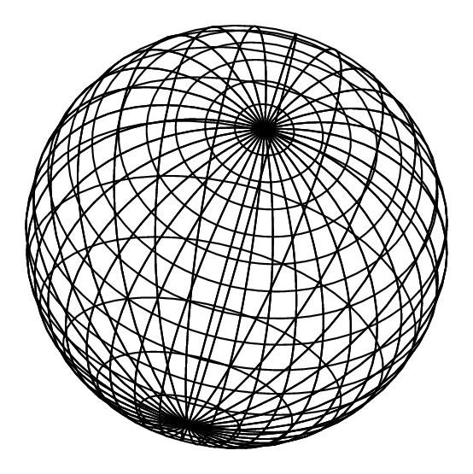
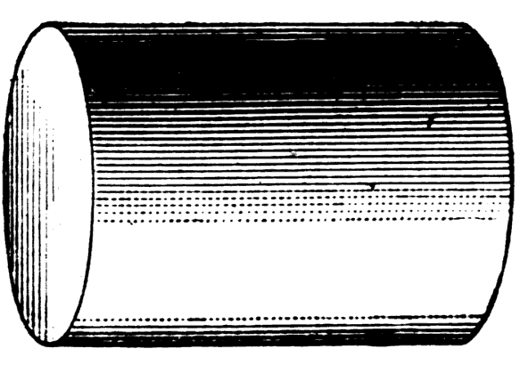
GLU
GLU is an OpenGL helper library
Uses GL to perform common tasks
For example: gluLookAt(), gluPerspective()
Allows drawing of common complex geometric models
Sphere
Cylinder
Disk

Slide 35
GLU Quadrics
Initializing
GLU glu = new GLU();
GLUquadric q = glu.gluNewQuadric();
Drawing
glu.gluSphere(q, radius, slices, stacks)
glu.gluCylinder(q, r1, r2, h, slices, stacks)
glu.gluDisk(q, r1, r2, slices, loops)
Clearing
glu.gluDeleteQuadric(q);

Slide 36
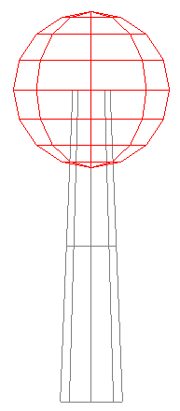
GLU Quadrics Example
// Setup local coordinate system
gl.glRotated(-90, 1, 0, 0);//maps y to -z
// Initialize quad
GLUquadric quad = glu.gluNewQuadric();
// Draw cylinder
gl.glColor3d(0.5, 0.5, 0.5);
glu.gluCylinder(quad, 0.1, 0.06, 1, 8, 2);
// Draw sphere
gl.glTranslated(0, 0, 1);
gl.glColor3d(1, 0, 0);
glu.gluSphere(quad, 0.25, 8, 8);
glu.gluDeleteQuadric(quad); //Clear from memory

Slide 37
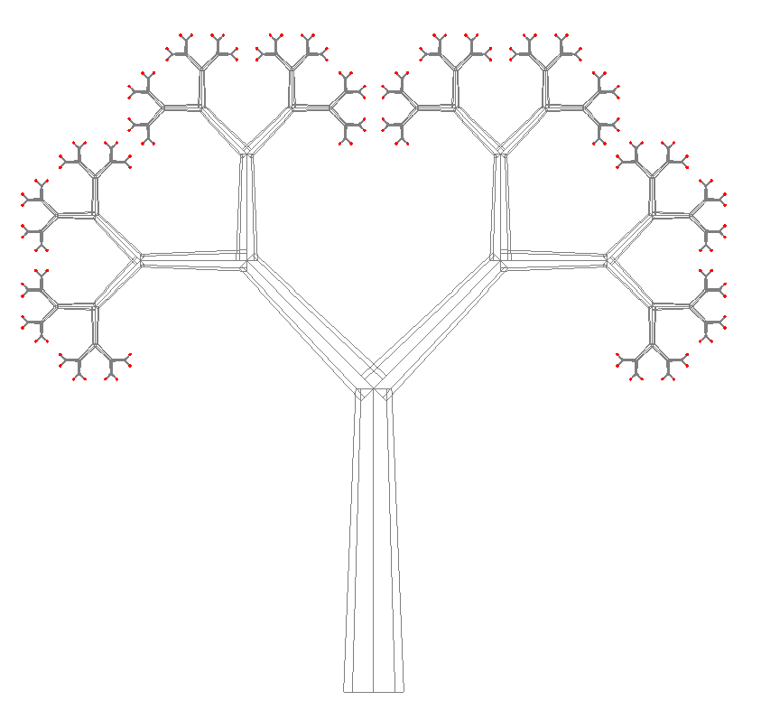

Slide 38
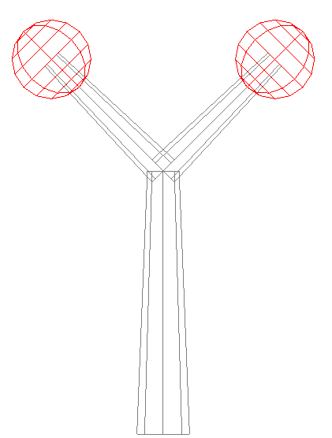
2D Fractal Tree Pseudo-code
drawTreeRec(level)
Draw Cylinder
Translate to cylinder end
If level = maxDepth
Draw Sphere
Return
Scale by factor
For split in 1..splits
Rotate by alpha=split*360/splits around z
Push matrix
Rotate by angle around y
drawTreeRec(level+1)
Pop matrix
angle
Z axis
apha
X axis

Slide 39
void drawTreeRec(GL gl, int level) {
GLUquadric quad = glu.gluNewQuadric();
// Draw cylinder
gl.glColor3d(0.5, 0.5, 0.5);
glu.gluCylinder(quad, 0.1, 0.1*factor, 1, 8, 1);
gl.glTranslated(0,0,1);
// Recursion stopping condition
if(level == maxDepth) {
// Draw red sphere
gl.glColor3d(1, 0, 0);
glu.gluSphere(quad, .25, 8, 8);
return;
}

Slide 40
…
// Setup local coordinate system for each child and draw
// The relevant variables are: angle, maxDepth, factor, splits.
double angleInc = 360.0/splits;
gl.glScaled(factor, factor, factor);
for (int i = 0; i < splits; ++i) {
gl.glRotated(angleInc, 0, 0, 1);
gl.glPushMatrix();
gl.glRotated(angle,0,1,0);
drawTreeRec(gl, level+1);
gl.glPopMatrix();
}
glu.gluDeleteQuadric(quad);
}

